Slide 1
Identify Abnormal Driving Behavior Using
Spatio-Temporal Analysis [UAV videos]
CSE 623 Machine Learning Theory and Practice
Group Name : Optic AI
Meet Patel(AU2444010)
Abhishek Gandhi(AU2444015)
Dhruvi Dalal(AU2444019)
Garima Jain(AU2444017)
Dhruv Patel(AU2444003)

Slide 2
Problem Statement
Driving Behavior Variations: While drivers are expected to follow similar patterns on the same road, real-world behavior differs due to individual decisions, road conditions, and external factors.
Data Source & Features: UAV videos provide vehicle trajectory data, capturing movement through spatial and temporal features such as speed variations, lane shifts, and acceleration patterns.
Need for Abnormality Detection: Identifying abnormal driving behavior is crucial for traffic safety, accident prevention, and autonomous vehicle applications.

Slide 3
Instructor’s Feedback
The instructor suggested exploring alternative algorithms such as Dynamic Time Warping (DTW) and other clustering techniques to improve performance. These methods could be more effective in handling spatio-temporal data for our project.
How can we perform classification between abnormal and normal trajectories based on the clustering results?

Slide 4
Trajectory Anomaly Detection: ML vs. Custom Approaches
Initial ML Approach :
Employed feature extraction (temporal, spatial, dynamic), custom DTW distance, and OPTICS clustering.
Custom Clustering Approach :
Method: Classifies trajectories into multiple clusters based on predefined rules and thresholds derived from domain knowledge.
Key Elements:
Feature Calculation: Computes trajectory properties like straightness, turning angles, distance moved etc…
Reference Angles: Establishes reference angles for horizontal and vertical straight movement from the data.

Slide 5
Workflow
Defines parameters and loads necessary libraries for the script's execution.
Computes reference angles from the trajectory data.
Classifies trajectories into "Normal" or "Abnormal" categories.
Load & Preprocess data
Apply Rules
Evaluate & Visualize
Setup
Calculate Zone & Refs
Map to Binary
Reads and prepares trajectory data from CSV files by resampling them.
Clusters trajectories based on a set of predefined movement-based rules.
Generates and saves visualizations of the clustered trajectories.

Slide 6
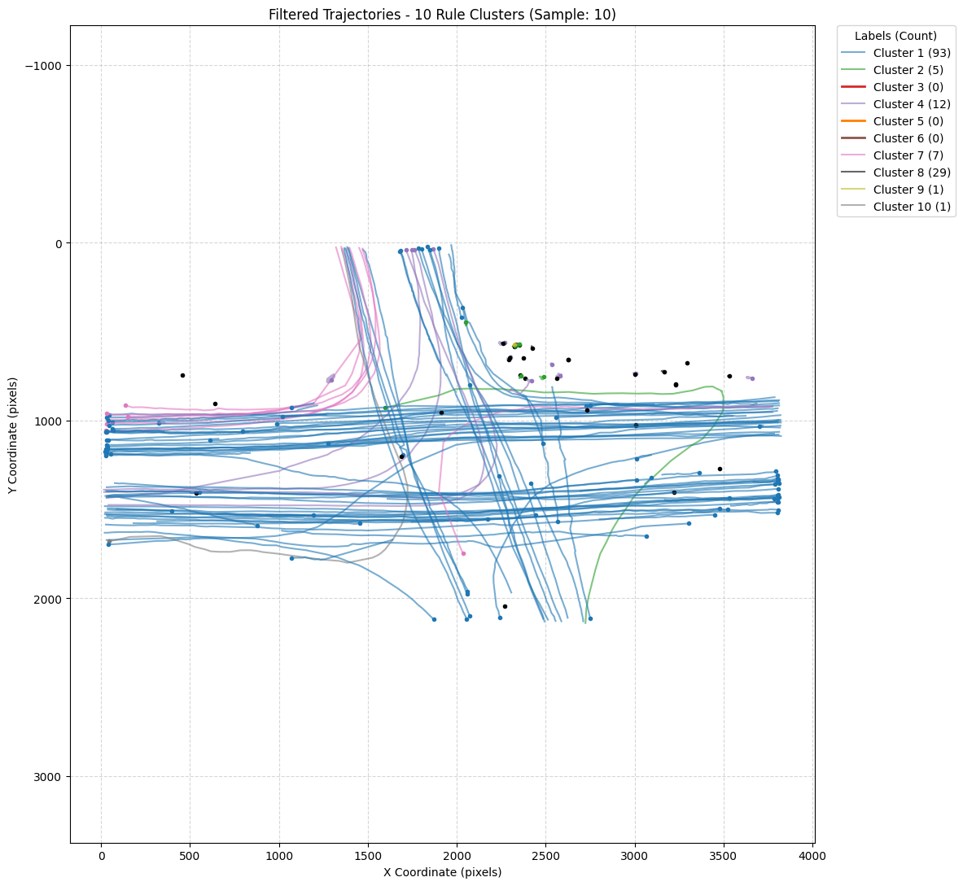
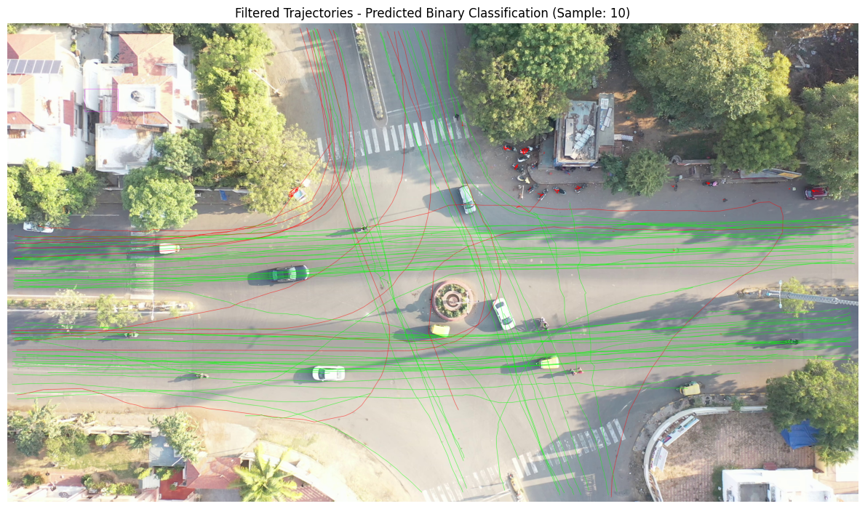
Results

Slide 7
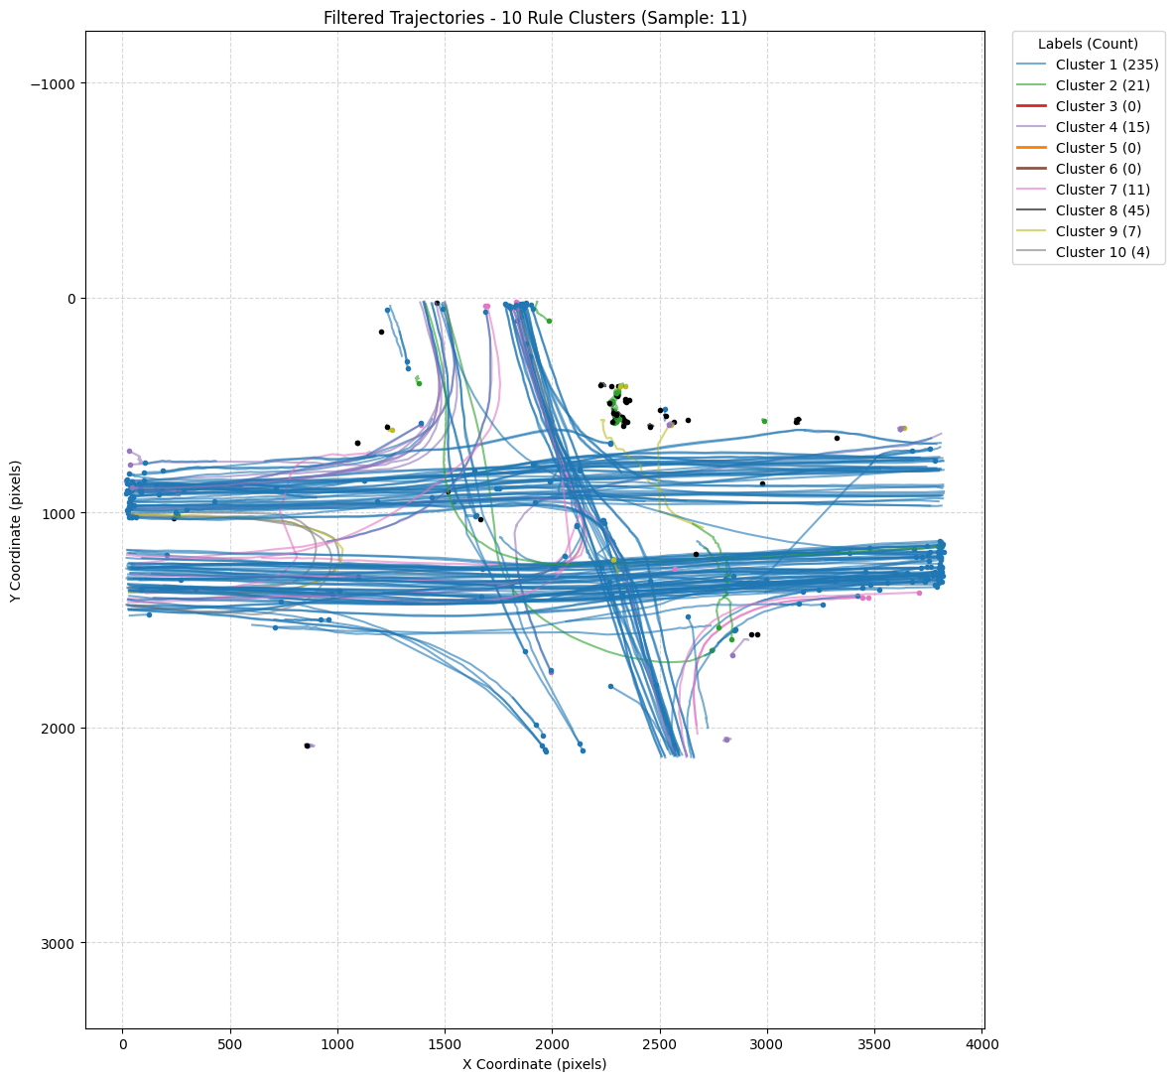
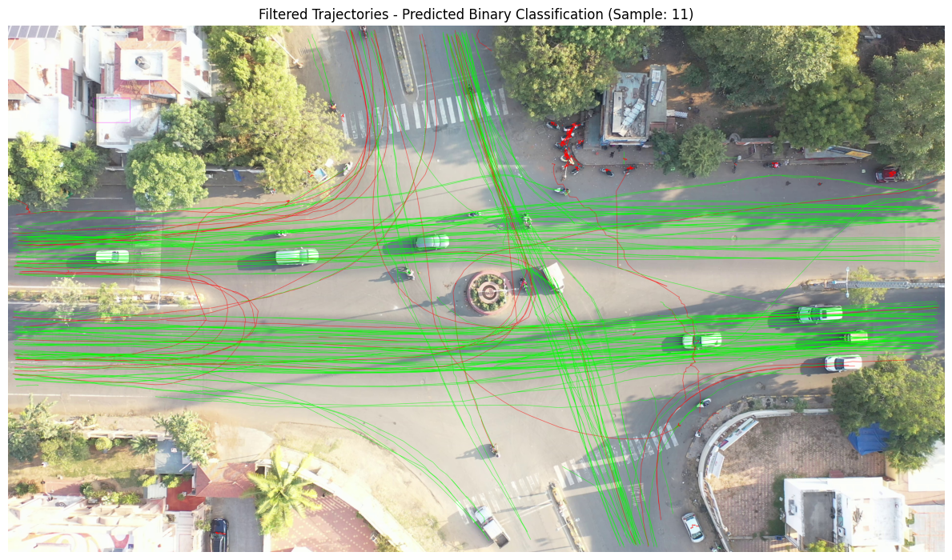
Results

Slide 8
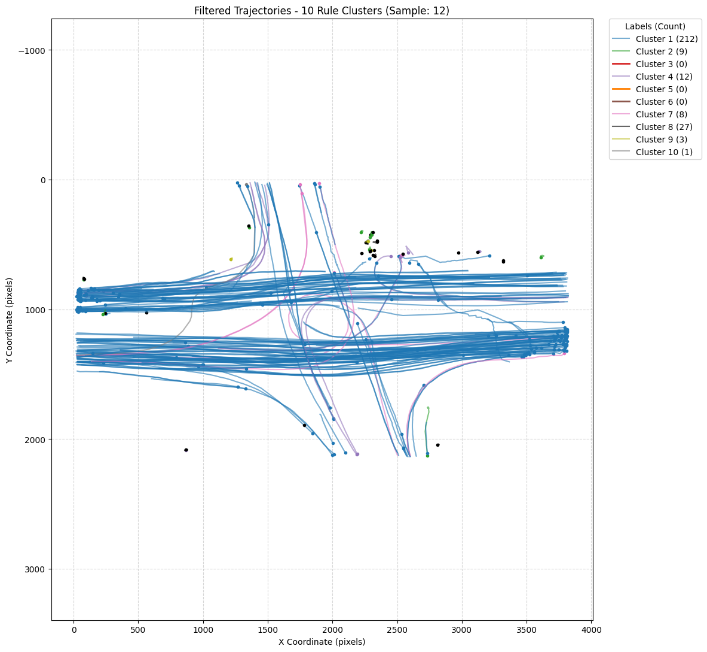
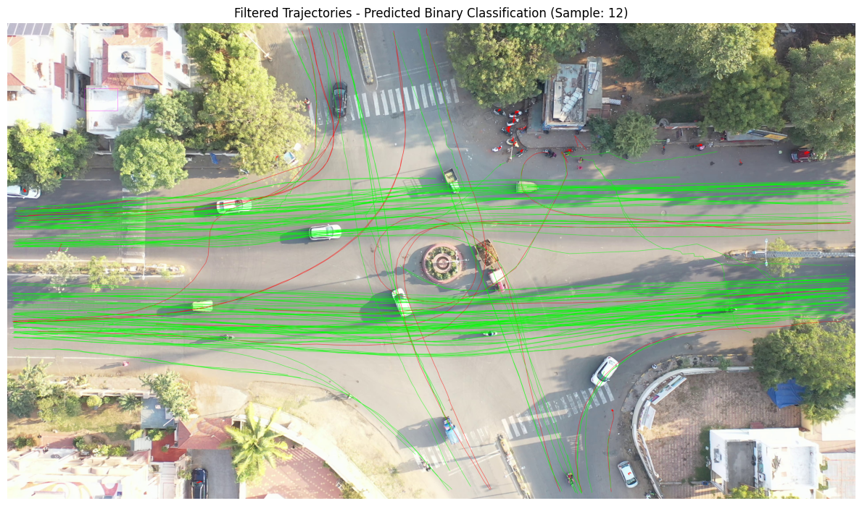
Results

Slide 9
Future Work
Enhance Rules: Optimize thresholds, add specific some rules, and refine kinematic analysis.
Hybrid ML: Combine rules with ML (e.g.,Clustering) for subtle anomalies and threshold tuning.

Slide 10
References
[1] Y. M. Bhavsar, M. S. Zaveri, M. S. Raval, and S. B. Zaveri, “Vision-based investigation of road traffic and violations at urban roundabout in india using uav video: A case study,” Transportation Engineering, vol. 14, p.100207, 2023.
[2] T.-A. Teo, M.-J. Chang, and T.-H. Wen, “Automatic vehicle trajectory behavior classification based on unmanned aerial vehicle-derived trajectories using machine learning techniques,” ISPRS International Journal of Geo-Information, vol. 13, no. 8, 2024. [Online]. Available:https://www.mdpi.com/2220-9964/13/8/264
[3] C. Zhang, S. Liu, M. Guo, and Y. Liu, “A novel ship trajectory clustering analysis and anomaly detection method based on AIS data,” Ocean Engineering, vol. 288, p. 116082, 2023.
[4] P. Banerjee and R. Nevatia, “Dynamics based trajectory segmentation for uav videos,” in 2010 7th IEEE International Conference on Advanced Video and Signal Based Surveillance. IEEE, 2010, pp. 345–352.
[5] J.-G. Lee, J. Han, and K.-Y. Whang, “Trajectory clustering: a partition- and-group framework,” in Proceedings of the 2007 ACM SIGMOD international conference on Management of data, 2007, pp. 593–604.
[6] R. Ranjith, J. J. Athanesious, and V. Vaidehi, “Anomaly detection using dbscan clustering technique for traffic video surveillance,” in 2015 Seventh international conference on advanced computing (ICoAC). IEEE,2015, pp. 1–6.
[7] J. Athanesious, V. Srinivasan, V. Vijayakumar, S. Christobel, and S. C.Sethuraman, “Detecting abnormal events in traffic video surveillance using superorientation optical flow feature,” IET Image processing, vol. 14,no. 9, pp. 1881–1891, 2020.

